Slide 1
ABS cohorts, providers and workforce analytical map.
23/11/2023
Will Walker

Slide 2
Analytical map
Assumptions/inputs
Analytical strand
What is an acceptable distance between KS5 sites?
To what extent can provision be diversified at tech collages?
Delivery timescales
Available funds
5. Delivery trajectories:
How will the expansion of capacity/workforce delivery progress towards full roll out?
Policy design elements:
Shape, nature and scope of compulsory Eng/Maths to 18 options
Incentives to study or not study specific subjects
2. Provider analysis:
How many KS5 providers are there that do not teach Eng/Maths?
Where is the nearest centre that does?
Where/how much might provider capability need to be extended?
How much multisite learning will be required?
1. Cohort analysis:
How many learners will take each route?
Where are they?
3. Workforce analysis:
How many additional teachers will be needed?
Which specialisms do they need?
Where will they be needed?
4. Cost:
What will delivery of this additional provision cost? Staff? Capital? Diversified tech collages etc.
General uncertain inputs:
Demographics
Future attainment (eligibility for different tracks)
Behavioural response of learners (choosing a pathway)
Behaviour of HE and employers (on value placed on pathways)
Cost of diversifying provision at specialised collages/facilitating multisite learning.
Cost of transporting learners between settings
Cost of hiring more teachers
Delivery timescales
Current expected teacher labour force over time (assumption?)
Required teacher specialism between L2/L3
GTH under ABS

Slide 3
1.1 Cohort analysis
Methodology:
Estimates to be made bottom up – i.e. we consider each pupil individually. This enable us to easily transform the cohort's attainment and size and will keep options open to answer a wide range of questions about the impact of the policy by location and pupil’s characteristics. This granularity will be essential for evaluating the distributions created by our assumptions about learners' choices, and to evaluate these in any depth. Reasonable answers to questions about coverage will require localised inputs created by this analysis.
Estimate size of cohort due to demographic changes over the next 10 years. (PPUs demographics project from earlier this year has already done this at a regional level).
Estimate Eng/maths attainment of this cohort over next 10 years. (I imagine changes to overall attainment can be made uniformly at first – assume a national distribution of attainment and shift up by x%.) potentially swap in regional figures later if of interest.
Based on current flow from GCSE to AS to A level, create range of assumptions about each type of learner's distribution entering each ABS track.
Apply policy assumptions about the shape and nature of the compulsorily ABS Eng/maths tracks, and assumptions about learner choices given their eligibility (based on attainment) for each track, to estimate the number on each route. Operate on a per pupil basis; given attainment tabularly roll to draw from their prospect of educational tracks. Technically this makes a Monte Carlo Model (!) but variations will cancel out on the aggregate picture.
Inputs:
Design of the ABS – what pathways exists for maths/Eng to 18? Major, Minor, L2 resit, below L2 etc
Demographics
Future attainment (eligibility for different tracks)
Behavioural response of learners (choosing a pathway):
How many who currently do/do not choose A levels in Eng/Maths will go for the major/minor etc.
Admin data on current flow from GCSE to AS to A level.
Resource requirement/ timescales:
A “quick” version of this can be worked up fast within a few days – I’m keen to demonstrate that this is deliverable.
Deploying the most recent data and fully sensitivity testing the inputs will take longer (end of w/c 27th)

Slide 4
1.2 Cohort analysis (simpler parallel methodology)
Inputs:
Design of the ABS – what pathways exists for maths/Eng to 18? Major, Minor, L2 resit, below L2 etc
Demographics
Future attainment (eligibility for different tracks)
Behavioural response of learners (choosing a pathway):
How many who currently do/do not choose A levels in Eng/Maths will go for the major/minor etc.
Admin data on current flow from GCSE to AS to A level.
Methodology:
Estimates to be made top down. We will work out the weighted proportions of learners who will end up on each track.
Estimate size of cohort due to demographic changes over the next 10 years. (extract directly from National pupil forecasts)
Estimate Eng/maths attainment of this cohort over next 10 years. Adjust distribution of KS4 attainment by simple modifiers.
Based on current flow from GCSE to AS to A level, create range of assumptions about each type of learner's distribution entering each ABS track.
Apply policy assumptions about the shape and nature of the compulsorily ABS Eng/maths tracks, and assumptions about learner choices given their eligibility (based on attainment) for each track, to estimate the proportion on each route.
Resource requirement/ timescales:
Once assumptions about learners per track has been worked up for 1.1 – straight forward excel based exercise to estimate aggregate student volumes.(1/2 days)

Slide 5
2. Workforce analysis
Inputs:
What are the GLH for each of the compulsory Eng/Maths track?
TWM projection of teacher supply (counterfactual/baseline)
Quantity of learners on each track at regional level (output of strand 1)
Methodology:
Based on estimated quantity of learners by track, we can estimate regional demand for additional teachers.
Resource requirement/ timescales:
If strand 1 has been completed according to plan, this strand shouldn’t take very long to execute.

Slide 6
3. Provider analysis
Inputs:
Data on the current size, occupancy and range of provision at all KS5 providers.
Quantity of learners on each track at regional level. (output of strand 1)
Assumptions about how much capacity can be diversified
Assumptions about acceptable commutable distances.
Methodology:
Identify which KS5 providers teach Eng/Maths at levels 2/3. Decide how to treat schools with ultra-low level of provision.
Identity the nearest institution which can cover this provision
Find capacity of L2/L3 English/Maths provision within planning areas (possible proxy for reasonable commutability and excess L2/3 capacity).
Based on assumptions about how much eng/maths L2/3 capacity can be diversified/exapcnded, and the limits of reasonable commutability, work out how many pupils need to commute from specialised settings to Eng/Maths centres, and how far they need to travel.
Analysis to be at pupil level.
Resource requirement/ timescales:
Work not an immediate priority (?)
Caspar to deliver until Xmas, learning requisite R capability enroute.

Slide 7
4.Cost analysis
Inputs:
Required additional number teachers/specialisms
Required diversified provision at technical KS5 spaces
Cost of diversifying provision at specialised collages/facilitating multisite learning.
Cost of transporting learners between settings
Cost of hiring more teachers
Delivery timescales (?)
Methodology:
Cost to be aggregated at national level, and sensitivity testing ranges to be applied based on policy/input uncertainties
Resource requirement/ timescales:
If previous steps have been executed as planned, this will not take that long.
Heavy dependence on completion of strand 2 on workforce, less so on strand 3 as coverage costs/impacts are likely to be smaller.

Slide 8
5. Delivery trajectories
Inputs:
Delivery timescales – what delivery milestones are we expecting.
Required additional teaching capability at technical collages etc.
Required extra number of teacher and specialisms.
Methodology:
Find a satisfactory way of “straight lining” between the status quo level of capacity/workforce, and the full roll out according to our policy scenarios.
Output will depend on if we creating an analytical driven target, or a delivery forecast
Resource requirement/ timescales:
If previous steps have been executed as planned, this will not take that long.
Heavy dependence on strands 2 and 3.
Strand 2 is most critical for the aggregate picture. (when we will say 95% ready, as coverage issues will affect a minority.)

Slide 9
ABS policy elements
Tracks available for compulsory subjects:
Major (L3)
Minor (L2)
Intermediate (L2.5)
Resits (L2 – foundation/higher paper)
Below L2

Slide 10
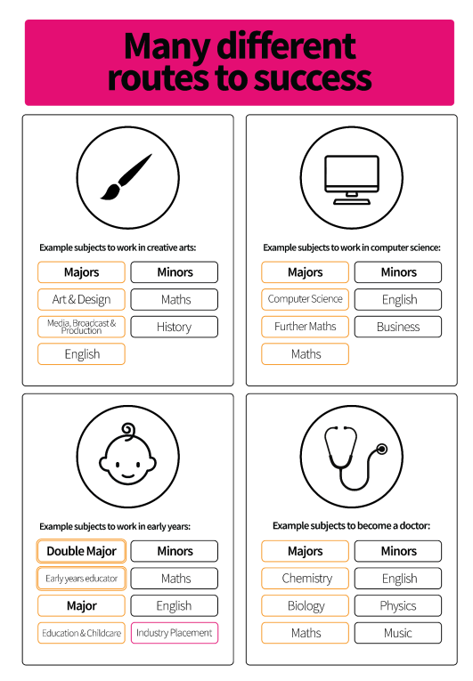
ABS cohort model
Micro simulation – based on the characteristics of the 2018/19 cohort (prior attainment), we have predicted which pathways individual learners would take under the ABS.
This granularity means we can assess the implications of ABS by a wide range of pupil characteristic (including by geography).
The model can adjust this cohort to fit with the predicted characteristics and size etc. of the cohort in 2033/34.
We can use this model to predict workforce implications, coverage or provision, equalities impacts etc. according to a wide range of policy/analytical assumptions.
This could also form the basis for generating delivery trajectories.
The model will help to identify a “cloud of uncertainty”- many model inputs and elements of the programme are highly uncertain.

Slide 11
Main assumptions and sensitivities
Assumption | Baseline values | Certainty | Sensitivity
Design of the ABS (L2.5 etc) | Maths and English have routes: Major, Minor, L2.5, GCSE resit, Below L2. 90% GLH of A level courses. (more on alternative routes). | Mid | High
Behavioural response of learners | Aligned to current | Low | High
Changes in attainment between now and 2033 | No further progress towards 90% Math/English GCSE target. | Low | High
Demographics | 2033/34 cohort is 8% larger | High | low
Workforce assumptions *simplified* | Most ABS routes require 20% more teaching | Mid | High
Apprenticeship take-up | Apprenticeship take-up remains around 5% | Low | High

Slide 12
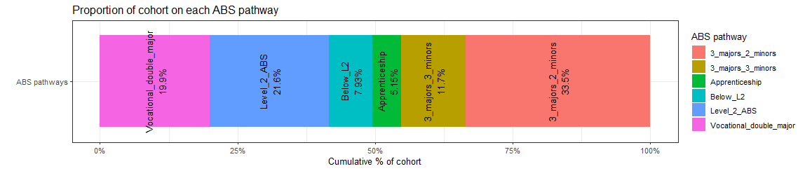
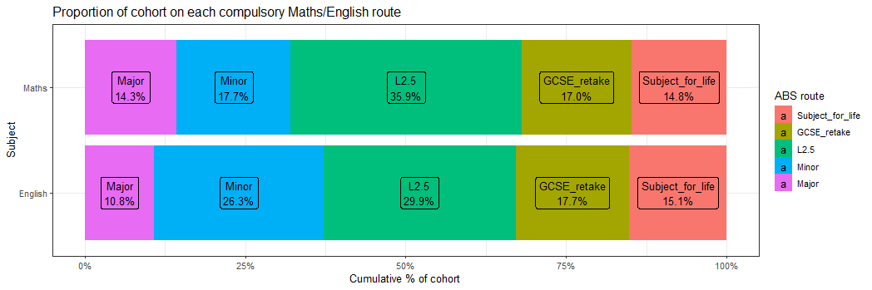
Initial outputs - learners on each route

Slide 13
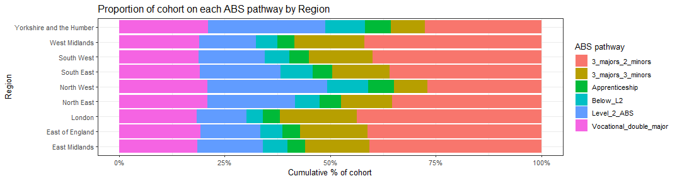
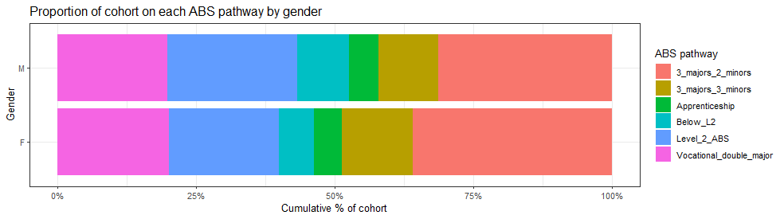
The granular model means we can explore this at a variety of levels, e.g.

Slide 14
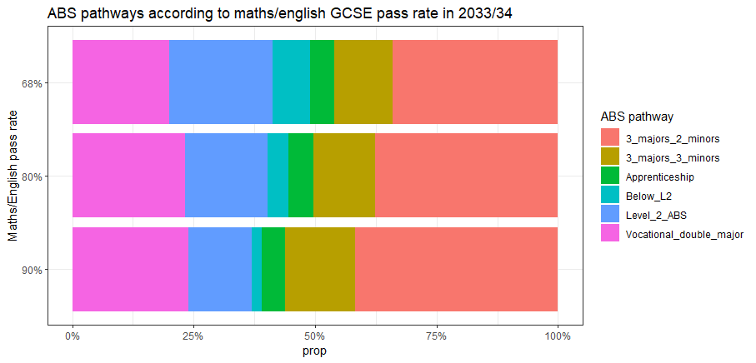
Routes by L2 pass rates

Slide 15
Simplified workforce implications approach
Simple comparison of GLH under ABS vs the legacy system to determine the relative “volume” of teaching that needs to be delivered.
How this is made up between, additional teachers, larger class, different teacher hours etc. can be worked up later.
ABS route | Legacy equivalent | Relative GLH
3 minors 3 majors (3x1 + 3x0.5)*90% = 4.05 | 4 A levels 4x1 = 4 | +0.05 (+1.25%)
3 minors 2 majors (3x1 + 2x0.5)*90% = 3.6 | 3 A levels 3x1 = 3 | +0.6 (+20%)
Vocational double major (1x2 + 1x1+ 2x0.5)*90% = 3.6 | Any vocational level 3 (T levels) (???) Assume 1x3 for now | +0.6 (+20%)
L2 ABS, Below L2 (3x1 + 2x0.5)*90% = 3.6 | GCSE’s or L2 vocational (???) Assume 1x3 for now | +0.6 (+20%)
Apprenticeships (out of scope) | Apprenticeships (out of scope) | +0%
Maths/English route | Relative GLH
A level | 100%
Old AS level | 50%
Major | 90%
Minor | 45%
L2.5 | 45%
GCSE | 45%
Subject of life | 45%

Slide 16
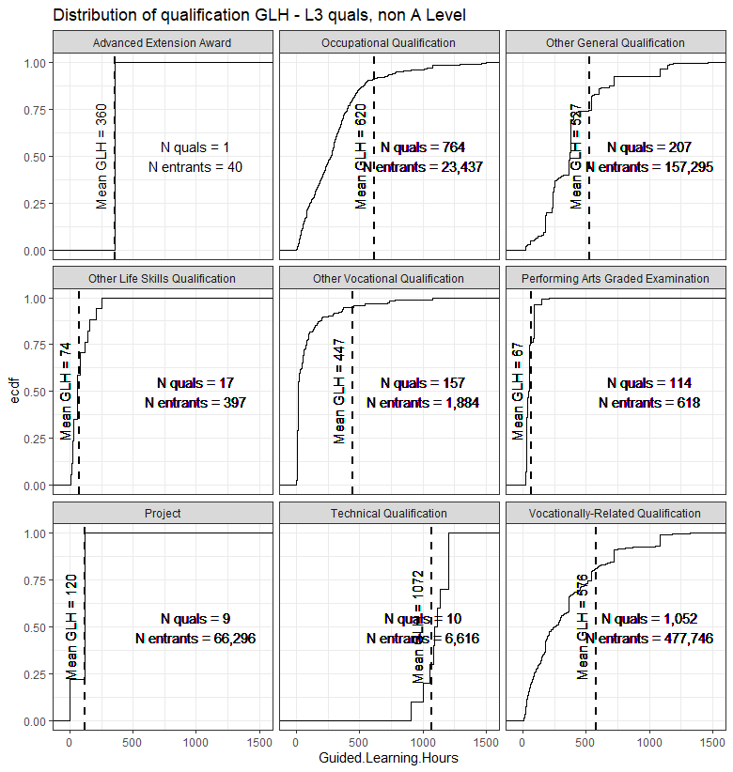
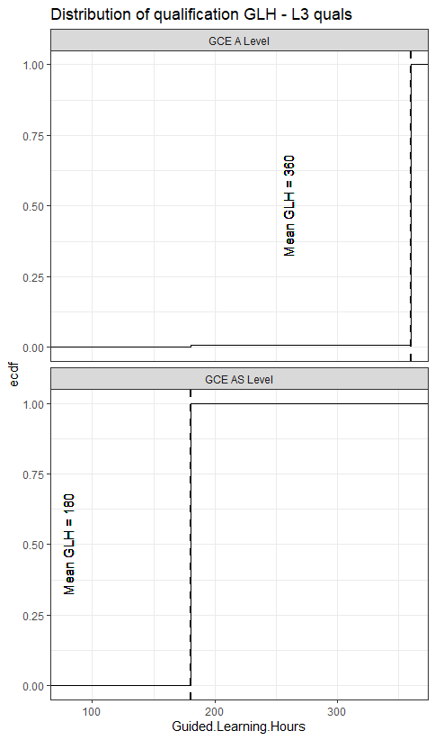
Existing qualification GLH

Slide 17
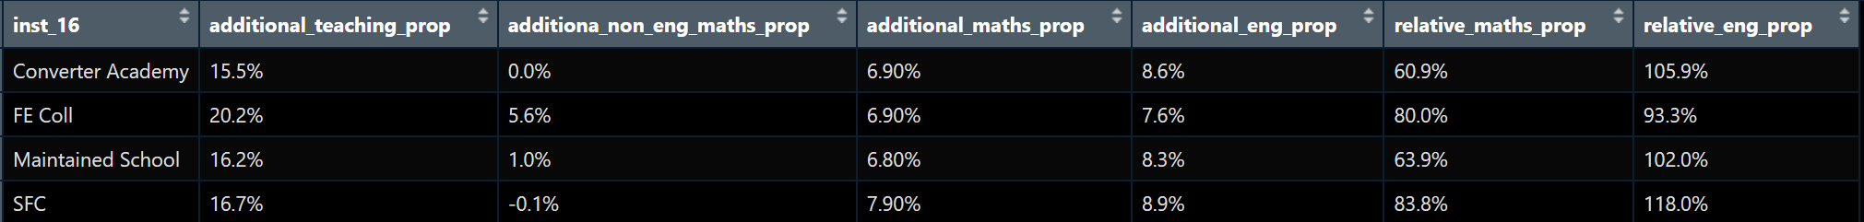
Additional workforce outputs [DRAFT]
Non-English and maths teaching will remain mostly stable
The ~18% rise in teaching is almost entirely comprised of maths and English
This twice as much English provision as the baseline, and 73% more maths.
Since this is a micro simulation, we can look at these outputs at a wide variety of levels….

Slide 18
Scenarios [??]
Uncertainties: Demographics, attainment, learners' choices and scope of policy (partition of L2/L3 compulsory subjects). Workforce is the main cost/delivery consideration of ABS. We will pool assumptions together which might lead to the largest and smallest impacts.
Baseline:
Attainment remains at current levels
Take up of English/maths majors closely aligns to current L3 and recent AS uptake. (leaners do the bare minimum)
Population aligns to national pupil forecast.
Apprenticeship take up remains at 5%
Scenario x:
Attainment, (L2 English/maths passes) progresses slightly (25%) towards 2030 target.
Some additional take up of majors in English and maths, among eligible learners.
Population aligns to national pupil forecast.
Apprenticeship take up rises to 10% ??
Scenario x:
Attainment, (L2 English/maths passes) progresses (50%) towards 2030 target.
Moderate take up of majors in English and maths, among eligible learners.
Population aligns to national pupil forecast.
Apprenticeship take up rises to 20% ??
Scenario x:
Attainment, (L2 English/maths passes) reaches 2030 target.
Relative enthusiasm for majors in English and maths, across span of eligibility.
Population aligns to national pupil forecast.
Apprenticeship take up rises to 40% ??

Slide 19
Progress so far
Individual level model
Adjusted for demographic and attainment changes
What maths and eng will everyone do, which ABS path will they do, what type of school will they attend? And where are they? (plus characteristics)
We’ve worked out the relative volume of teaching for the paths taken by pupils
How much capacity at each type of school by LA, or how much provision at existing school for each strand (if everyone attends the same institutions)

Slide 20
Next steps
QA of phase 1 analysis (code)
Sense check assumptions workshop with woijeic and someone from FE. Required me to make smooth documentation to explain how the model works.
Revisit the question we set to kevin and isaac
Formalise scenarios – something that will come out of sense checking..
Gaps analysis stuff – scope something and get this signed off by Kevin plus stakeholders… see where Nabila got too…

Slide 21
Issues tree
1a. Who are the providers and what are their characteristics?
Type
Size (e.g. student numbers)
Location (including urban/rural split)
Quality
Cohort characteristics e.g. disadvantaged, SEND
1b. What does each provider offer in terms of subjects? .g. offers most/all A level and T Level options, Only Tech levels etc.
1c. What provider does the current cohort of students (to decided which cohort) attend and what do they offer?
1d. How do students with different characteristics differ in their provider choice? E.g. SEND, disadvantaged etc.
1. What does the current 16-19 provider market look like?
Initial focus
Q: What changes are needed to the 16-19 provider landscape to deliver the ABS reforms effectively and efficiently?
2a. How will the ABS change what a provider needs to deliver?
Offer of English and maths
Subject breadth conditions – academic and technical
Other scenarios?
2b. Based on the above, which of the current providers would be able to offer the ABS now based on their current breadth of offer, and which could not?
2c. What are the characteristics of those providers that can/cannot? (focusing on the characteristics listed in 1a.)
2d. Where are there cold spots where there is no / insufficient capacity for students to access the full breadth of the expected ABS within a reasonable distance?
2e. What changes are required to reach the end-state (e.g. does the current market have the capacity/capability to deliver the ABS)?
2f. What do we want the 16-19 provider market to look like to ensure the ABS is delivered?
2g. What are the wider aims for the 16-19 market beyond ABS delivery?
2. What does the 16-19 provider market need to look like to deliver the ABS (i.e. the end state)?
3. How do we achieve this end-state to deliver ABS?
3a. What are the key differences between the current state and end state? ​
3b. What are the different options to reach this end-state? What levers can we use to make these changes ​ e.g. legislation / regulation, funding, comms etc.?
3c. What are the cost and deliverability implications of each of these options? To be considered further as phase 2 of the project.
3d. What other challenges will need to be considered (e.g. estates, workforce) To be considered further as phase 2 of the project.

Slide 22
Work force implications by Level of teaching specialism [OLD]
Assumptions
Baseline years are 2016-18 - before maths to 18 was developed and began rolling out
ABS GLH are 90% of current L3.
We have assumed: 17 learners per class, 5 classes per week for a major, 2.5 for other routes. Teachers deliver 19.9 hours of teaching a week.
[draft] Indicative initial findings
Our ABS model predicts we need an extra ~ X,X00. The maths to 18 model predicted we need ~ 3,500-7,000 additional maths teachers. (figures are excluding the current shortfall).
Whether there is a distinct L2.5 option will significantly effect the proportion of these that require specialism to teach L3 maths.

Slide 23
2 scenarios
Early implementation
Slower and considering more subjects

